Slide 1

Optimizing E-commerce Sales:
Price Recommendation using Machine Learning Techniques

Slide 2

Problem Description
An E-commerce website wants us to build an algorithm that automatically suggests the right product prices from the user-inputted text descriptions of their products, including details like product category name, brand name, item condition, etc.
The goal is to solve the problem of suggesting the appropriate price of products to online sellers.

Slide 3


Solution Methodology
Data Collection
Data Cleaning
Data Visualization
Apply ML Models
Analyzing Results
Feature Engineering
Apply Same Models
Some Changes
Apply Different Models
Final Result

Slide 4
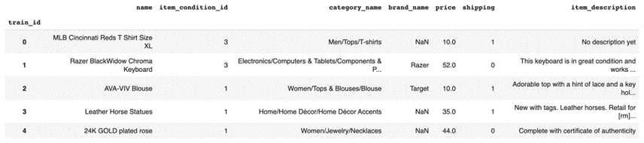
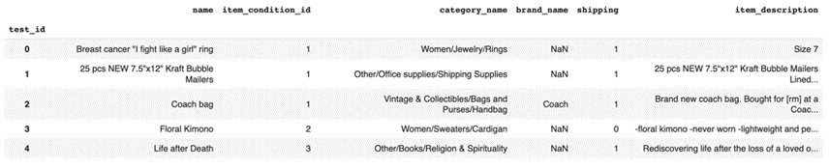
Training Dataset
Data Collection
(1482535, 8)
The dataset has been taken from Kaggle.
Test Dataset
(693359,7)

Slide 5





Removed rows with Price < 0
Data Cleaning
Merge both Dataset
Split the Category Column in three parts

Slide 6
Removed any missing values
Data Cleaning
Transform some columns
Tokenize and Lemmetize item_description

Slide 7

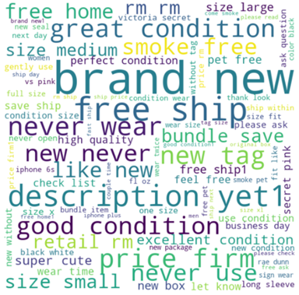
Data Visualization
Word Cloud of item description
Most Frequent Words
brand, new
Average Used Words
bundle, save
Less Used Words
brand new1, free ask

Slide 8
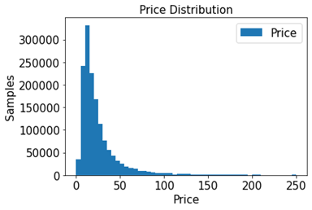
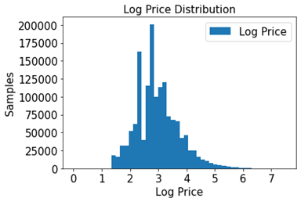
Data Visualization
Price and Log Price Distribution
Log price appears to be more symmetric and centered around a mean value.

Slide 9
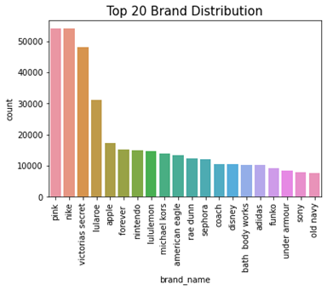
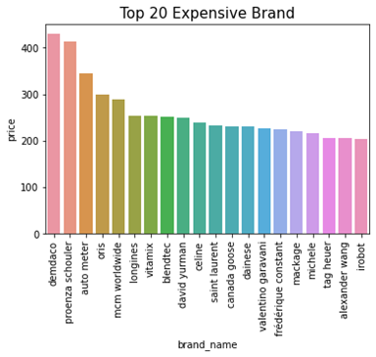
Data Visualization
Top 20 Brand and Top 20 Expensive Brand

Slide 10
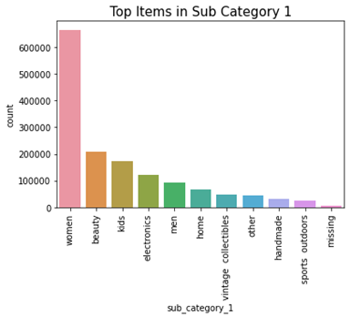
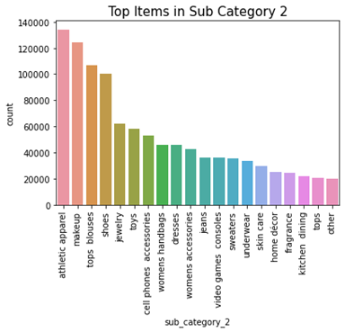
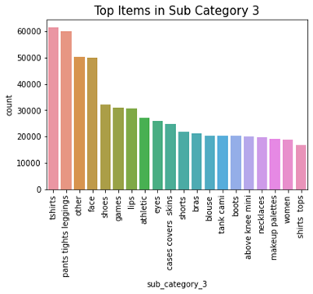
Data Visualization
Frequent Sub Categories of Item
From these visualizaation, we can conclude that the highest sale is coming from women category.

Slide 11
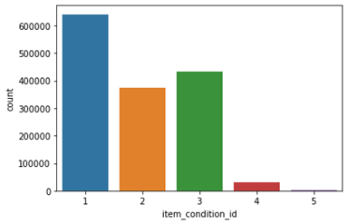
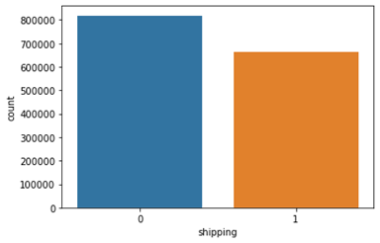
Data Visualization
Item Condition Id and Shipping

Slide 12
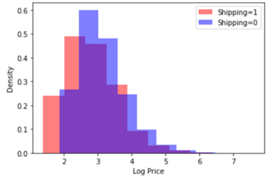
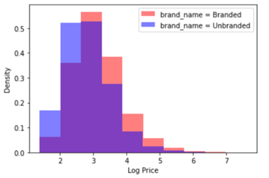
Data Visualization
Comparison of product price on shipping and brand

Slide 13
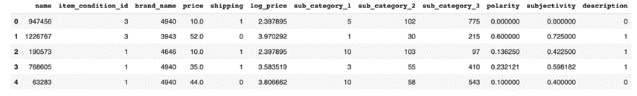
Label Encoding and Sentiment Analysis
Once the label encoding and sentiment analysis is done,
our merge dataset looks like this

Slide 14
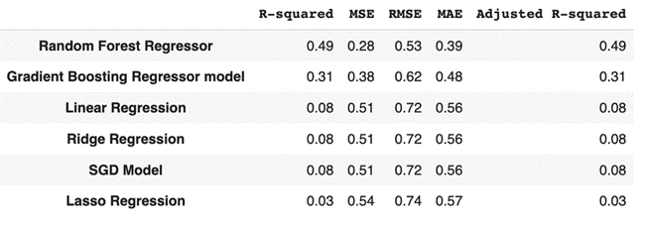
Models and Results
Further analysis is necessary to identify additional relevant features that could improve the accuracy of the models.

Slide 15
Feature Engineering
name_first
description_lower_count
name_first_count
description_upper_count
sub_category_1_count
name_len
sub_category_2_count
des_len
sub_category_3_count
name_desc_len_ratio
brand_name_count
desc_word_count
name_lower_count
mean_des
name_upper_count
desc_letters_per_word

Slide 16
Feature Engineering
name_letters_per_word
DescriptionPunctCountRatio
NameLowerRatio
NameDigitCount
NameUpperRatio
DescriptionDigitCount
DescriptionLowerRatio
NameDigitCountRatio
DescriptionUpperRatio
DescriptionDigitCountRatio
NamePunctCount
weird_characters_desc
DescriptionPunctCount
weird_characters_name
NamePunctCountRatio

Slide 17
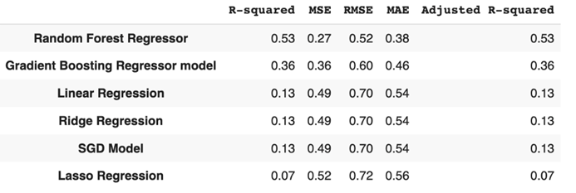
Models and Results
Some changes are necessary that could improve the accuracy of the models.

Slide 18

Tfidf Vectorize
item_description
Label Binarizer
Tfidf Vectorize and
Label Binarize
brand_name, sub_category_1, sub_category_2, sub_category_3
Label Encoding
name, name_first
Convert to standard form
Convert into sparse matrix

Slide 19
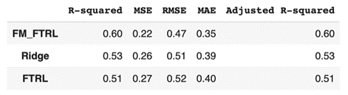
Models and Results
Their is an improvement from our ealier approach, and FM_FTRL worked best in above all models. So, we will use this model to recommend price.

Slide 20
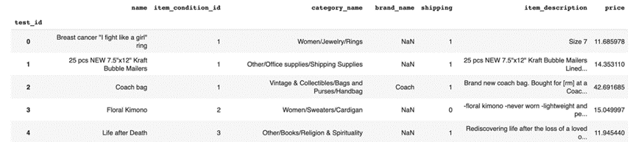
Final Prediction
We used FM_FTRL model to make predictions on the unseen test data, and obtained the predicted logarithm of prices and then we converted it to normal price.

Slide 21
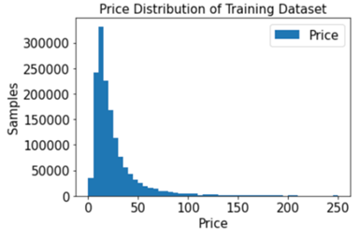
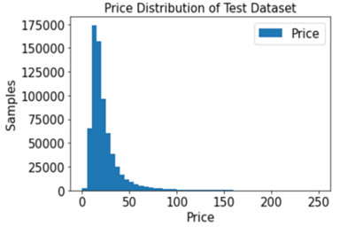
Data Visualization
Price Distribution of Training and Test Dataset
The distributions of actual prices and predicted prices are almost similar. The predicted prices seem to capture the general shape of the price distribution, but may not be as accurate in capturing the extreme values.

Slide 22
Conclusion
Based on the analysis performed, we have developed a model to predict the prices of items based on their descriptions, category names, and other relevant features. We have used a machine learning model, namely FM_FTRL to achieve the best possible results with R2 of 0.60.
We have also compared the distribution of the price of both the training and test sets and observed that they are quite similar. This indicates that our model has not overfit to the training data and should perform well on unseen test data

Slide 23
Thank You!

